Slide 1
Veolia Presentation
Francois DEBERGH

Slide 2
Veolia Group Essentials

Slide 3
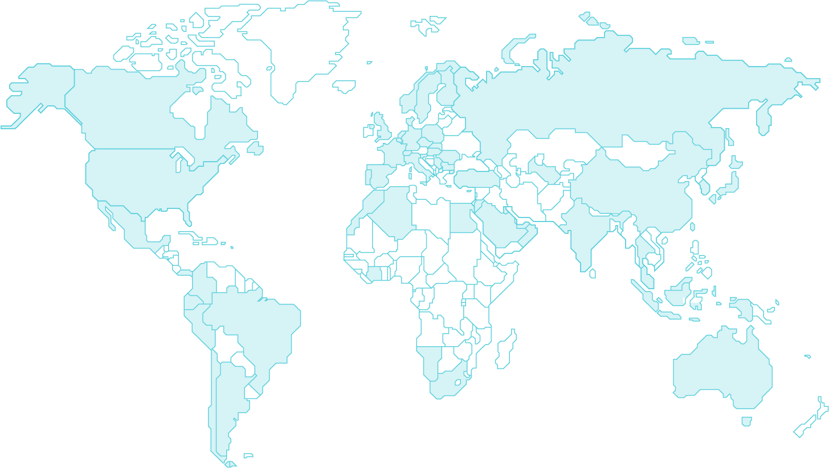
A WORLD LEADER A STRONG GEOGRAPHICAL PRESENCE
Close to 218 000 employees worldwide
57 countries
on 5 continents
€45,351 million revenue

Slide 4
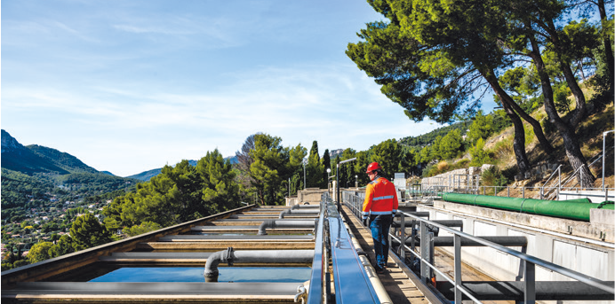
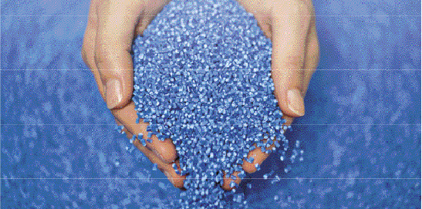
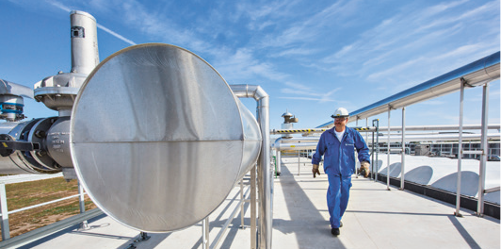
3 MAIN BUSINESSES IN NUMBERS
WATER
113 million people supplied with drinking water
103 million people connected to wastewater systems
3,809 drinking water production plants managed
3,222 wastewater treatment plants managed
WASTE
43 million people provided with collection services on behalf of municipalities
63 million metric tons of treated waste
562,828 business clients
865 waste processing facilities operated
ENERGY
42 TWh produced
48,745 thermal installations managed
708 heating and cooling networks managed
2,118 industrial sites managed

Slide 5
GREENUP: VEOLIA’S 2024-27
STRATEGIC PROGRAM
OBJECTIVE
Greening our municipal and industrial clients' activities, while becoming the missing link in ecological transformation.
AMBITION
Accelerating the deployment of concrete, affordable, duplicable solutions that depollute, decarbonize, and regenerate our resources.
BOOSTERS
Decarbonizing, depolluting, and regenerating resources through three growth boosters: bioenergy, flexibility and energy efficiency ; water technologies and new solutions ; hazardous waste treatment.
Discover GreenUp strategic program

Slide 6
SOLUTIONS TO ADDRESS
OUR MAIN CHALLENGES
DECARBONIZATION
Veolia designs solutions for the climate that decarbonize our lifestyles and production methods and adapt them to the consequences of climate disruption.
ECONOMY & REGENERATION OF RESOURCES
Veolia invents green energy systems, recovers waste in the form of materials or energy, and promotes the recycling and reuse of wastewater and plastics.
DEPOLLUTION
Water, soil, air... Veolia offers a range of solutions to treat all types of pollution. The Group is a recognized player in the treatment of hazardous waste and degraded soil, and is a specialist in indoor air quality.

Slide 7
KEY POSITIONS MUNICIPAL MARKET
Commercial
MUNICIPAL WATER
LOCAL LOOPS OF ENERGY
Armenia > whole Country
Bulgaria > Sofia
Czech Republic > Prague, Olomouc, ScVK, KHP & SVAS
Germany > several municipalities in Saxony-Anhalt
Hungary > Budapest, Szeged
Poland > Tarnowskie Gory
Romania > Bucharest, Ploiesti
Slovakia > Banska Bystrica, Poprad
Bulgaria > Varna
Czech Republic > Prague Left & Right Banks, Ostrava, Olomouc
Germany > BS Energy (Braunschweig), municipalities in Saxony
Hungary > Budapest (BERT), Pecs, Debrecen, Szakoly, Dorog, and Ajka
Poland > Warsaw, Poznan, Lodz
Slovakia > Bratislava, Levice, Ziar nad Hronom, Lucenec, Brezno
Uzbekistan > Tashkent
SOLID WASTE TREATMENT, RECYCLING & VALORIZATION
WATER TECHNOLOGIES, TREATMENT PLANTS AND NETWORKS
Czech Rep. > Recovera (formerly Suez Waste CZ)
Germany > Veolia Umweltservices (Paper, PET & Plastics, Bio-/Food waste), BellandVision (Dual “EPR” systems and packaging recycling)
Poland > EKO ZEC
Serbia > Vinca (Belgrade) Waste to energy
Slovenia > Biotera
Czech Republic, Hungary, Romania, Serbia, Slovakia

Slide 8
Veolia Bulgaria

Slide 9
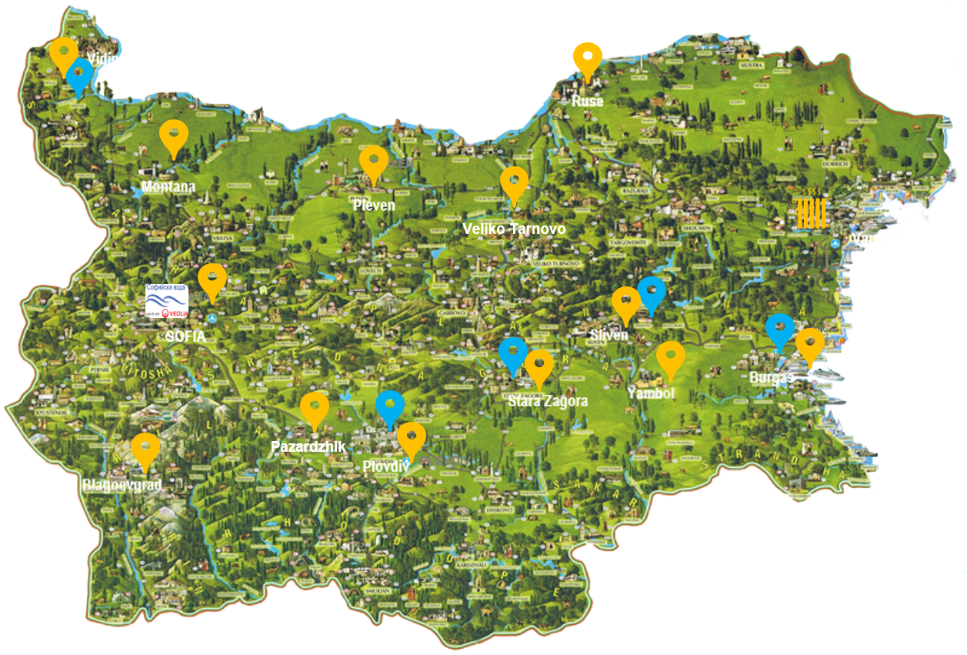
Veolia in Bulgaria
Municipal water and wastewater services
District heating network
Water services
Energy services
180+ engineers & technical experts based in the main cities

Slide 10
Veolia in Bulgaria – Our BUs
ACCESS TO WATER &
SANITATION
LOCAL LOOPS OF
ENERGY
BES & OSS
Sofiyska Voda
Sofia water concession
Full water cycle management
for 1,5 M inhabitants
4 DWTP & 2 WWTP
Distribution water network:
3,702 km
Sewerage network: 1,768 km
Green energy: 23,4 GWh/year
Water Network Efficiency: 70%
Varna District Heating
District heating services including
Cogeneration of electricity
84 MWhth Thermal energy
67 MWhel Electricity (cogeneration)
36 km of DH network
Veolia Energy Solutions
On site services to industrials and building energy services (BES)
SOLID WASTE
Development capabilities in Waste to Energy & recycling activities

Slide 11
www.sofiyskavoda.bg
www.veolia.bg

